Slide 1
RQC (round 2)
NIST internal presentation by Gorjan Alagic
(borrowing heavily from RQC docs)

Slide 2
overview
RQC (“Rank Quasi-Cyclic”)
Code-based KEM
Team: Carlos Aguilar Melchor, Nicolas Aragon, Slim Bettaieb, Loïc Bidoux, Olivier Blazy, Alain Couvreur, Jean-Christophe Deneuville, Philippe Gaborit, Adrien Hauteville, Gilles Zémor
Usual route:
  RQC.PKE: IND-CPA scheme (based on hardness of syndrome decoding in some structured code)
  RQC.KEM: Apply (some version of) FO to boost RQC-PKE to IND-CCA2
  RQC.HE: IND-CCA2 PKE (generic conversion from RQC.KEM)
Positives: zero decryption failure rate, good performance, security proof, good team + docs.
Negatives: assumption is about structured codes and seems largely untested
sizes in bytes
timings in ms

Slide 3
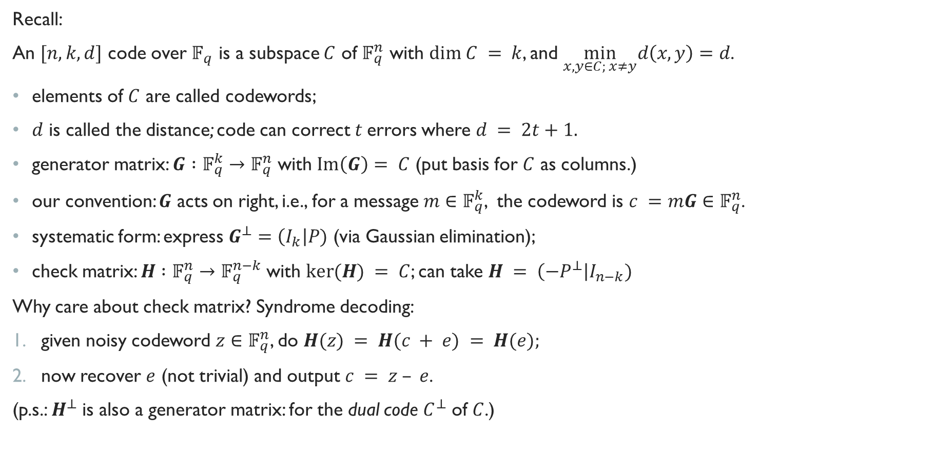
Linear codes over Finite fields
Hamming distance
Rank
Recall:
An $[n,k,d]$ code over $𝔽_{q}$ is a subspace $C$ of $𝔽_{q}^{n}$ with $dim C = k$, and $\min_{x, y∈C; x≠y}d\left(x,y\right)=d$.
elements of $C$ are called codewords;
$d$ is called the distance; code can correct $t$errors where $d = 2t+1.$
generator matrix: $G :𝔽_{q}^{k}→𝔽_{q}^{n}$ with $Im\left(G\right)= C$ (put basis for $C$ as columns.)
our convention: $G$ acts on right, i.e., for a message $m∈𝔽_{q}^{k}$, the codeword is $c =mG∈𝔽_{q}^{n}$.
systematic form: express $G^{⊥}=\left(I_{k}\right|P)$ (via Gaussian elimination);
check matrix: $H :𝔽_{q}^{n}→𝔽_{q}^{n−k}$with $ker⁡(H) = C$; can take $H = \left(−P^{⊥}\right|I_{n−k})$
Why care about check matrix? Syndrome decoding:
given noisy codeword $z∈𝔽_{q}^{n}$, do $H(z) = H(c + e) = H(e);$
now recover $e$ (not trivial) and output $c = z – e$.
(p.s.: $H^{⊥}$ is also a generator matrix: for the dual code $C^{⊥}$ of $C$.)

Slide 4
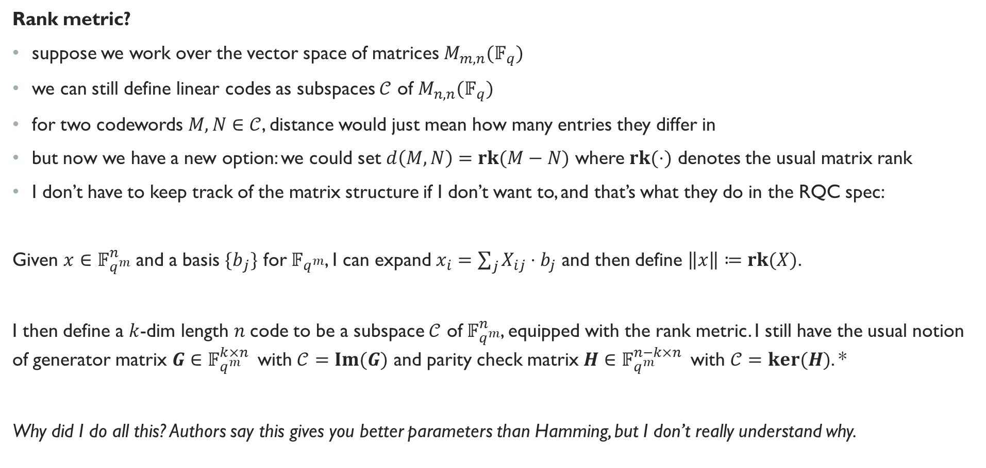
Rank metric
Rank metric?
suppose we work over the vector space of matrices $M_{m,n}(𝔽_{q})$
we can still define linear codes as subspaces $𝒞$ of $M_{n,n}(𝔽_{q})$
for two codewords $M, N∈𝒞$, distance would just mean how many entries they differ in
but now we have a new option: we could set $d\left(M,N\right)=rk(M−N)$ where $rk(⋅)$ denotes the usual matrix rank
I don’t have to keep track of the matrix structure if I don’t want to, and that’s what they do in the RQC spec:
Given $x∈$ $𝔽_{q^{m}}^{n}$ and a basis ${\{b}_{j}\}$ for $𝔽_{q^{m}}$, I can expand $x_{i}=\sum_{j}{X_{ij}⋅b_{j}}$ and then define $\left\|x\right\|≔rk(X)$.
I then define a $k$-dim length $n$code to be a subspace $𝒞$ of $𝔽_{q^{m}}^{n}$, equipped with the rank metric. I still have the usual notion of generator matrix $G∈𝔽_{q^{m}}^{k×n }$ with $𝒞=Im(G)$ and parity check matrix $H∈𝔽_{q^{m}}^{n−k×n }$ with $𝒞=ker⁡(H)$. *
Why did I do all this? Authors say this gives you better parameters than Hamming, but I don’t really understand why.
*with the usual convention that $G$ acts on right and $H$ on left

Slide 5
Gabidulin codes
Gabidulin codes

Slide 6
Gabidulin codes
Gabidulin codes

Slide 7
“Hard problems”
Rank syndrome decoding problem
RQC relies on the presumed hardness of these problems for the special case of ideal codes;
these are basically quasi-cyclic codes
systematic form looks like this:
circulant matrices
(more or less)

Slide 8

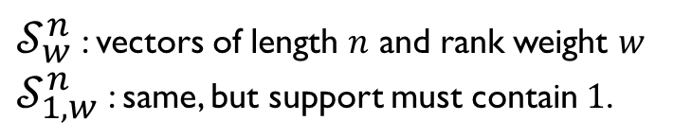
RQC.PKE
View from Mars (kinda LWE-like):
secret key is a vector $y$ (plus other stuff.)
to encrypt $m$, output $c ≔(u, v)$ where $u$ is random-ish and $v=mG+stuff$.
to decrypt $c$, output $Decode(v −u⋅y)$.
Details:
$𝒮_{w}^{n}$ : vectors of length $n$ and rank weight $w$
$𝒮_{1, w}^{n}$ : same, but support must contain $1$.
can show this is indist from random by a special case of DRSD, by thinking of $\left(1,h\right)$ as a parity check matrix

Slide 9
RQC.KEM and RQC.HE
RQC.KEM: from RQC.PKE via standard FO transform
RQC.HE: Hybrid Encryption. Just a CCA2-secure PKE created by doing whatever we mean by “a generic conversion” from KEM to PKE.

Slide 10
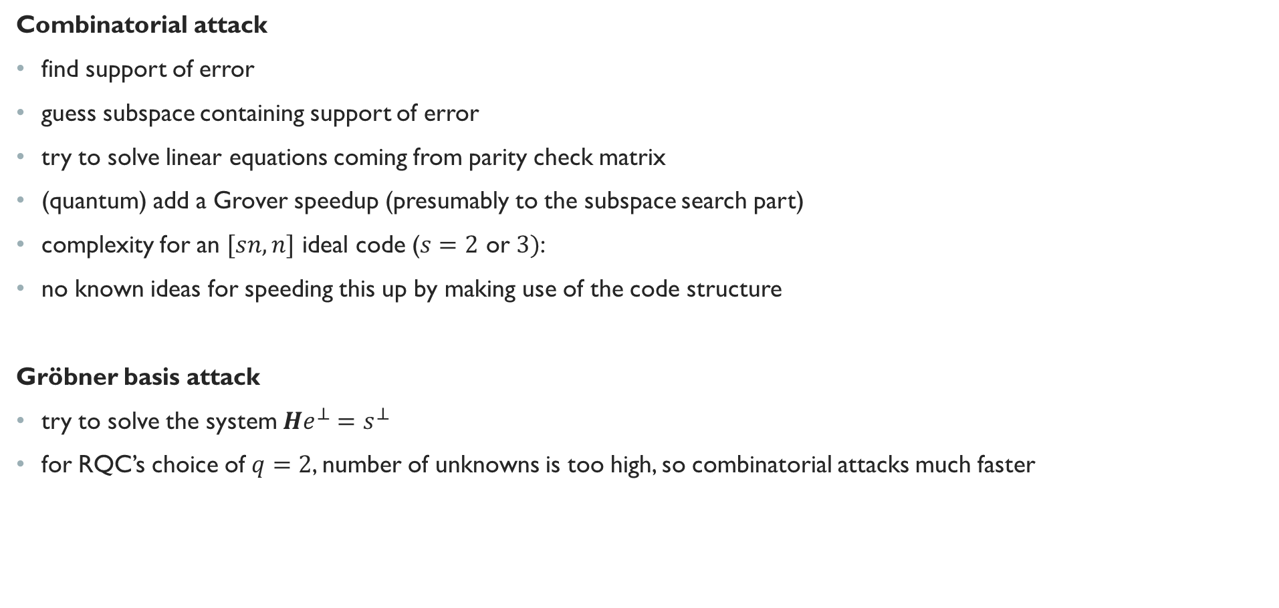
attacks
Combinatorial attack
find support of error
guess subspace containing support of error
try to solve linear equations coming from parity check matrix
(quantum) add a Grover speedup (presumably to the subspace search part)
complexity for an $[sn, n]$ ideal code ($s=2$ or $3)$:
no known ideas for speeding this up by making use of the code structure
Gröbner basis attack
try to solve the system $He^{⊥}=s^{⊥}$
for RQC’s choice of $q=2$, number of unknowns is too high, so combinatorial attacks much faster

Slide 11
Round 2 changes

Slide 12
parameters

Slide 13
overview
RQC (“Rank Quasi-Cyclic”)
Code-based KEM
Team: Carlos Aguilar Melchor, Nicolas Aragon, Slim Bettaieb, Loïc Bidoux, Olivier Blazy, Alain Couvreur, Jean-Christophe Deneuville, Philippe Gaborit, Adrien Hauteville, Gilles Zémor
Usual route:
  RQC.PKE: IND-CPA scheme (based on hardness of syndrome decoding in some structured code)
  RQC.KEM: Apply (some version of) FO to boost RQC-PKE to IND-CCA2
  RQC.HE: IND-CCA2 PKE (generic conversion from RQC.KEM)
Positives: zero decryption failure rate, good performance, security proof, good team + docs.
Negatives: assumption is about structured codes and seems largely untested
sizes in bytes
timings in ms

Slide 14
QTESLA (round 2)
NIST internal presentation by Gorjan Alagic

Slide 15
overview
Ring-LWE based signature scheme
Team: Nina Bindel, Sedat Akleylek, Erdem Alkim, Paulo S. L. M. Barreto, Johannes Buchmann, Edward Eaton, Gus Gutoski, Juliane Krämer, Patrick Longa, Harun Polat, Jefferson E. Ricardini, Gustavo Zanon
A lot of schemes…
… many of which are now broken in a very embarrassing way!
The remaining schemes might be alright…
… but it seems unclear if the submitters understand their security.
In particular, the security proofs seem flawed (according to Lyubashevsky on 4/27; no response yet from submitters.)
On the other hand, no break yet.
But unless there’s a serious fix & response, qTesla seems in trouble. I will sketch the problem in lieu of a normal presentation.

Slide 16
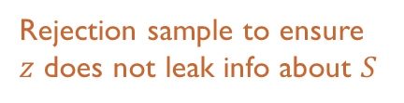

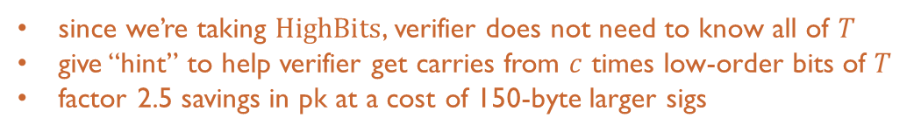
The basic idea
A basic LWE signature idea:
Generate some LWE keys: $(A, T≔AS+E)$
To sign a message $μ$, do:
  sample a random $y$, compute $w=HighBits(Ay)$;
  compute hash $c≔H(w, μ)$;
  set $z≔y+Sc$;
  output $(z, c)$.
To verify a signature $(z, c)$ of message $μ$:
  Compute $w′=HighBits(Az−Tc)$;
  Return $c==H\left(w^{′}, μ\right).$
Check: $Az−Tc=(Ay+ASc) −\left(ASc+Ec\right)=Ay−Ec$.
commit
challenge
Rejection sample to ensure
$z$ does not leak info about $S$
response
since we’re taking $HighBits$, verifier does not need to know all of $T$
give “hint” to help verifier get carries from $c$ times low-order bits of $T$
factor 2.5 savings in pk at a cost of 150-byte larger sigs

Slide 17
The basic idea
A basic LWE signature idea:
Generate some LWE keys: $(A, T≔AS+E)$
To sign a message $μ$, do:
  sample a random $y$, compute $w=HighBits(Ay)$;
  compute hash $c≔H(w, μ)$;
  set $z≔y+Sc$;
  output $(z, c)$.
To verify a signature $(z, c)$ of message $μ$:
  Compute $w′=HighBits(Az−Tc)$;
  Return $c==H\left(w^{′}, μ\right).$
Check: $Az−Tc=(Ay+ASc) −\left(ASc+Ec\right)=Ay−Ec$.
commit
challenge
Rejection sample to ensure
$z$ does not leak info about $S$
response
since we’re taking $HighBits$, verifier does not need to know all of $T$
give “hint” to help verifier get carries from $c$ times low-order bits of $T$
factor 2.5 savings in pk at a cost of 150-byte larger sigs

Slide 18
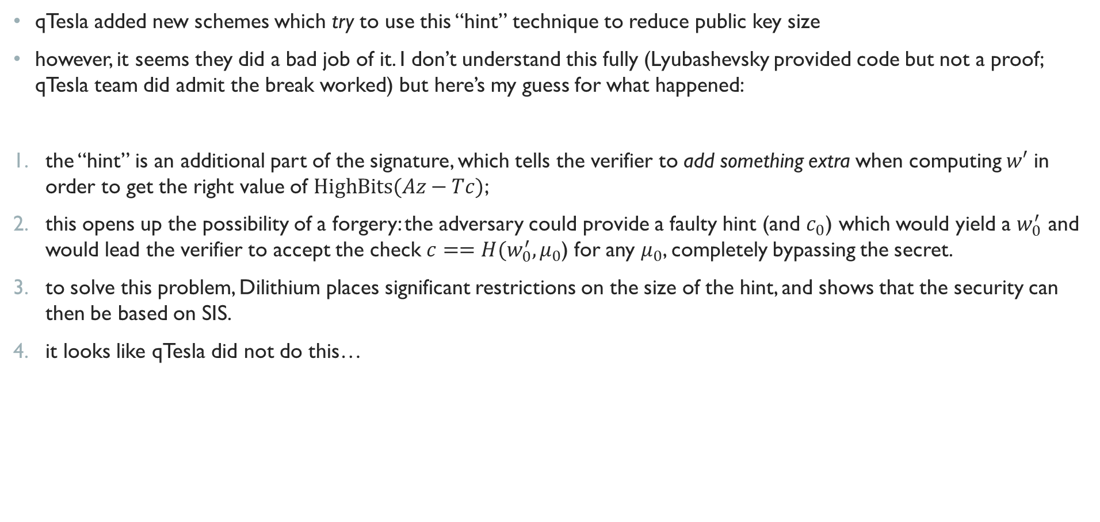
THE PROBLEM
qTesla added new schemes which try to use this “hint” technique to reduce public key size
however, it seems they did a bad job of it. I don’t understand this fully (Lyubashevsky provided code but not a proof; qTesla team did admit the break worked) but here’s my guess for what happened:
the “hint” is an additional part of the signature, which tells the verifier to add something extra when computing $w′$ in order to get the right value of $HighBits(Az−Tc)$;
this opens up the possibility of a forgery: the adversary could provide a faulty hint (and $c_{0}$) which would yield a $w_{0}^{′}$ and would lead the verifier to accept the check $c==H(w_{0}^{′}, μ_{0}$) for any $μ_{0}$, completely bypassing the secret.
to solve this problem, Dilithium places significant restrictions on the size of the hint, and shows that the security can then be based on SIS.
it looks like qTesla did not do this…
qTesla round 2 doc

Slide 19
THE PROBLEM
… and Lyubashevsky and Schwabe pounced:
the qTesla team agreed that the affected schemes are indeed broken, but claimed the rest of the schemes are just fine, citing their security proofs
Lyubashevsky then gave an argument that one can break the rest of the schemes using a Ring-SIS oracle
this is troubling, because qTesla’s claimed security proof only relies on hardness of Ring-LWE
I have not verified this. If the qTesla team disputes it, we can wade into the details to see what’s up.
We (Peter Schwabe and I) give a complete break of (3) - in particular, a signing algorithm for arbitrary messages that doesn't require the use of the secret key and is faster than the qTesla signing algorithm (which uses the secret keys). Peter's code is available at …

Slide 20
THE surviving schemes

Slide 22
THE surviving schemes

Slide 25
Round 2 changes (major)
Signing algorithm changed to probabilistic (instead of deterministic).
New parameter sets proposed: three heuristic and two provably-secure parameter sets.
Original Gaussian sampler based on the Bernoulli-based rejection sampling is replaced by a new portable and constant time CDT-based Gaussian sampler that does not require floating-point arithmetic.
Added new AVX2-optimized implementations for the heuristic parameter sets.
Revised conjecture used in the security reduction. Explained the usage of the conjecture in context and provided a heuristic argument for why it is true. Added a script to experimentally search for possible counterexamples.
Added parameter sets for levels II and V.

